Slide 1
CSE 220
Jannatun Noor
Jannatun.noor@bracu.ac.bd
Lecture Made by: Aminul Huq

Slide 2

Linear Array
In a ``normal'' linear array, the first available slot is at index 0 and ends with index arr.length - 1

Slide 3
Circular Array
In a circular array (also called circular buffer), the end of the array wraps around to the start of the array
Simply watch the second hand of a watch go from 0 to 59, and then wrap around to 0 again, and you see a circular array at work.
In a circular array the first element may start at any index, not necessarily at index

Slide 4
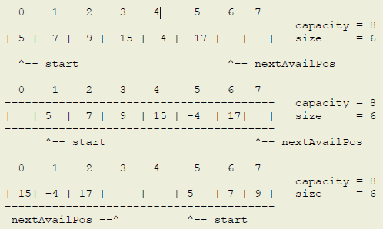
Example

Slide 5
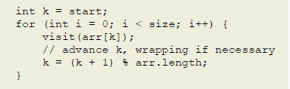
Forward & Backward Traversing
Suppose an array named arr [6] = {3,4,5,6,7,8}
i | size | i < size | k | arr[k] | (k+1)%arr.length
i | size | i < size | k | arr[k] | (k+1)%arr.length
0 | 6 | Y | 0 | 3 | (0+1)%6 = 1
1 | 6 | Y | 1 | 4 | (1+1)%6 = 2
2 | 6 | Y | 2 | 5 | (2+1)%6 = 3
3 | 6 | Y | 3 | 6 | (3+1)%6 = 4
4 | 6 | Y | 4 | 7 | (4+1)%6 = 5
5 | 6 | Y | 5 | 8 | (5+1)%6 = 0

Slide 6
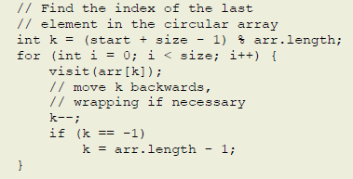
Assignment 1
Create a Tracing of the backward traversal

Slide 7
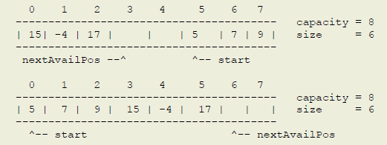
Linearizing a Circular Array
Linearizing a circular produces a linear array where the first element is at index 0, and the last element is at index size - 1. It's basically copying the circular array into a linear one, element by element, such that circArr[start] -> linearArr[0], circArr[start + 1] -> linearArr[1], circArr[start + 2] -> linearArr[2], and so on.

Slide 8
Insertion
In a circular array, the position is not the index, but rather it is the offset from the front element. You can compute the index into the underlying array using the by-now familiar relation
(front + offset) % circArr.length.
Inserting into a circular array is no different that inserting into a linear array — we need to shift elements one position to the right to create a space for the new element.
we need to know the following:
1. the index where to start shifting, and
2. the number of elements to shift.

Slide 9
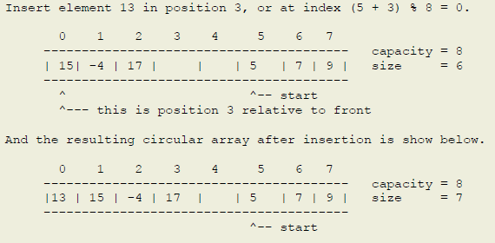
Example

Slide 10
Insertion
we are often given the offset from the front element (which is exactly what the index is for a linear array!), so we have to first compute the index where to start the shift. Once we know that, the process is exactly the same!
The number of elements to shift is given by size - offset

Slide 11
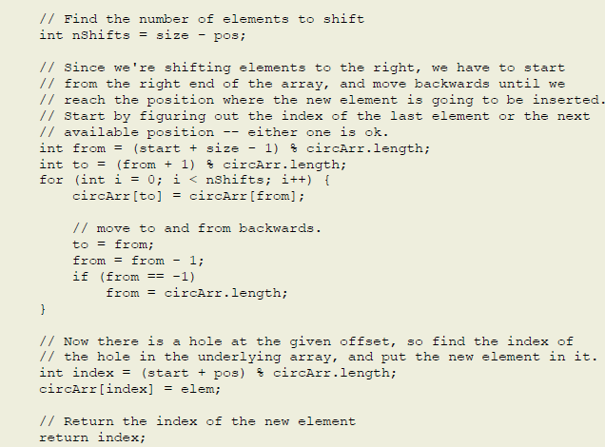

Slide 12
Removing an element
we have to plug the hole left by removed element by shifting elements to the left by one position.
to shift elements, we need to know the following:
1. the index where to start shifting, and
2. the number of elements to shift.
we are often given the offset from the front element (which is exactly what the index is for a linear array!), so we have to first compute the index where to start the shift. Once we know that, the process is exactly the same! The number of elements to shift is given by size - offset - 1

Slide 13
Removing an element
We can do it one of two ways:
Shift all subsequent elements to the left by one position, which is the way we remove an element from a linear array (so we call it the usual way). The code to do that is shown below. This is the first way of doing it in the illustration above.
Shift the elements from the front to the given element right by one position, and then advance front. This is only possible for a circular array, since we can treat any index as the starting position. This is the second way of doing it in the illustration above.

Slide 14
